Slide 1
TRAVEL AND TOURISM MANAGEMENT SYSTEM
BY:-
NANDAN A
SUBHASH S

Slide 2
INTRODUCTION
Admin enter user id and password for login to enter Master Module Screens.
Admin can maintain his data sources.
Customer will call/visit with trip details.
Customer enters his complete Itinerary details with dates and time.
Administrator will enter vehicle, Hotel and activity details with tariff
Administrator giving information to generate various kinds of MIS reports.

Slide 3
ADMINISTRATOR MODULE
Admin can have his own home page
Keeping track of sites
Maintaining track of Bookings and Reservations

Slide 4
USER MODULE
User will enter customer details and generate Itinerary
User will generate the cost of Activity and whole Itinerary bill.

Slide 5
OBJECTIVES
Different kind of reports is generated by administrator to take various decisions.
Reports can be converted to various formats as required by users that is word document , Excel, rtf, pdf formats.
Booking ticket and maintenance of locations, and other resources is done by administrator

Slide 6
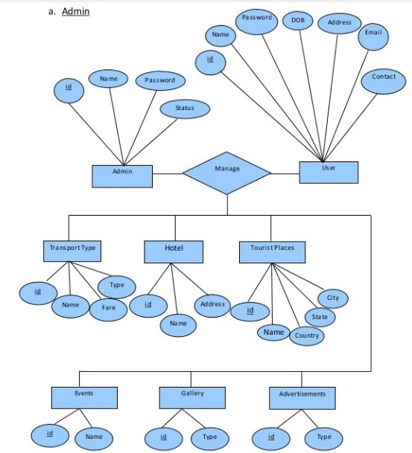
ER DIAGRAM:-

Slide 7
SCOPE
Any tourist agency can make use of it for saving customer details in database
Tourism group can use it for managing their location, hotel, vehicles details.
This application can easily implemented under various situations .
Add new features as and when we require.
Reusability of this application is also possible.

Slide 8
CONCLUSION
“Travel and tourism management” simplifies the management process in travelling.
Fast processing and immediate results with high security.
Minimizing human effort and cost efficient databases.
Navigation through the site is easy.

Slide 9
THANK YOU

